Slide 1
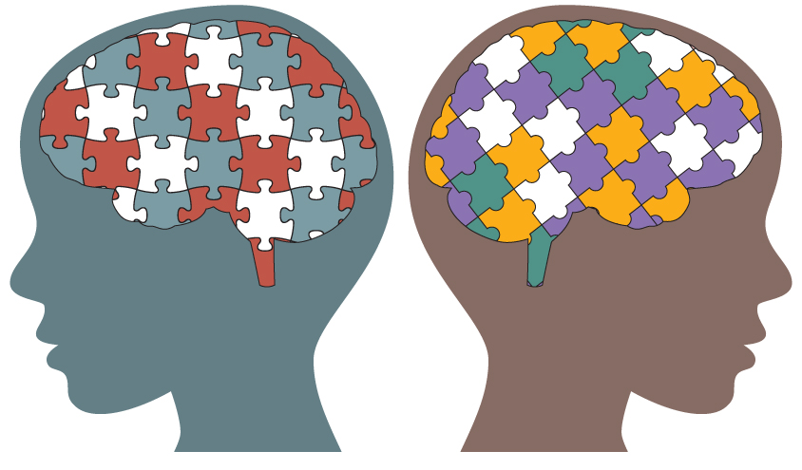
Autism Screening for toddlers

Slide 2

AGENDA
Business Case
Data Acquisition
Data Preparation
Data Visualization
Feature Selection
Predictive Modeling
Evaluation

Slide 3
BUSINESS CASE
What is Autism? characterized by challenges with social skills, repetitive behaviors, speech and nonverbal communication
1 in 59 children in the US affected today
Development of easy & effective screening methods is crucial
Objective of this study is to provide a predictive model to detect autistic traits
The HCP may recommend multi-disciplinary assessment after this initial screening
Notes:
Acc. To Centers for Disease Control and Prevention (CDC), autism increased 15% in the last 3 years
Early intervention helps

Slide 4

DATA ACQUISITION
The dataset was developed by Dr Fadi Fayez Thabtah using a mobile app called ASDTests to screen autism in toddlers
Data was obtained in csv format

Slide 5
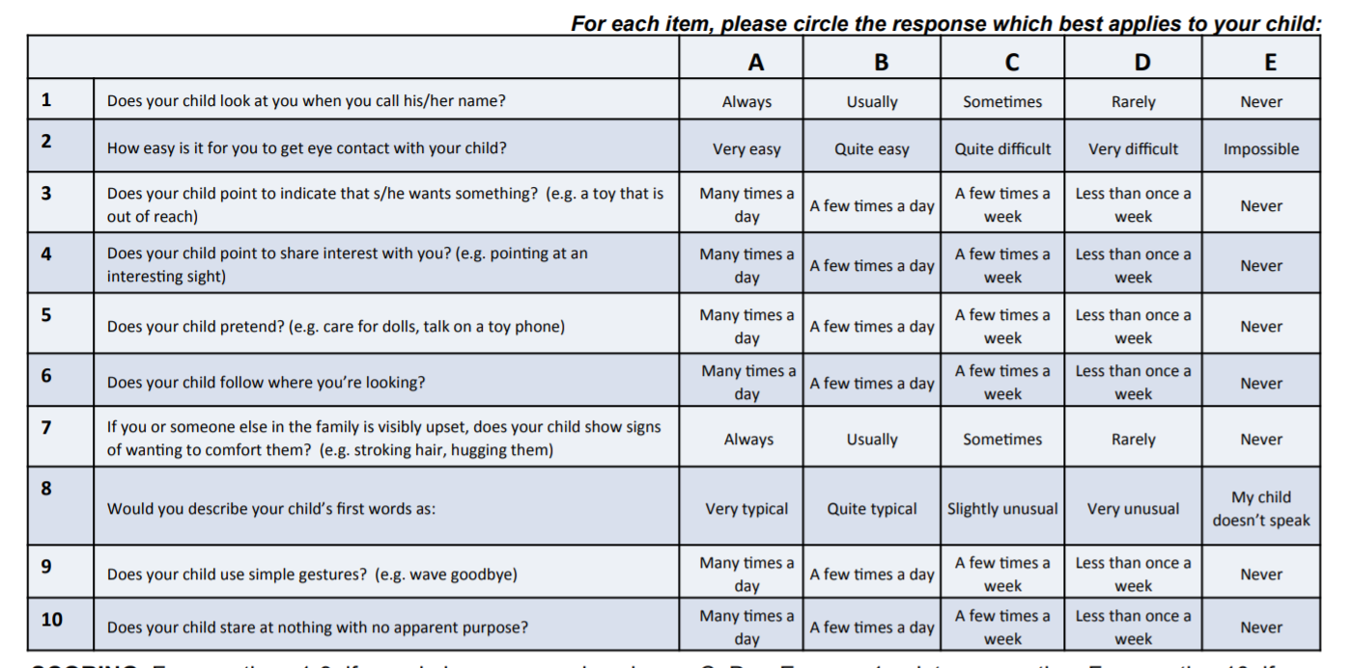
DATA ACQUISITION
Questions 1-9: For an answer in columns C, D or E, score 1 point per question.
Question 10: if you circle an answer in columns A, B or C, score 1 point
Other data points tracked: Age in mnths, sex, ethnicity, any family members with autism, Jaundice at birth

Slide 6
DATA PREPARATION
There are 1054 records of raw data
There are 19 features
2 noise features are removed
No duplicate values found in the dataset
No missing values found in the dataset
100% of original data is retained for data analysis

Slide 7
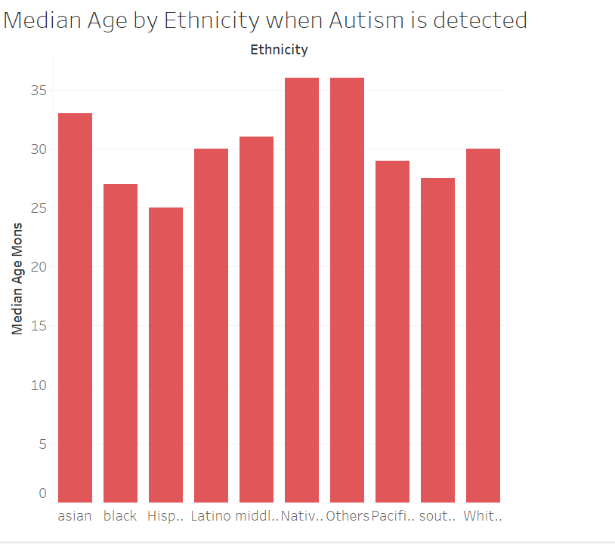
DATA VISUALISATION
The earliest age Autism is detected in Hispanics and the latest age Autism is detected is in Pacifica

Slide 8
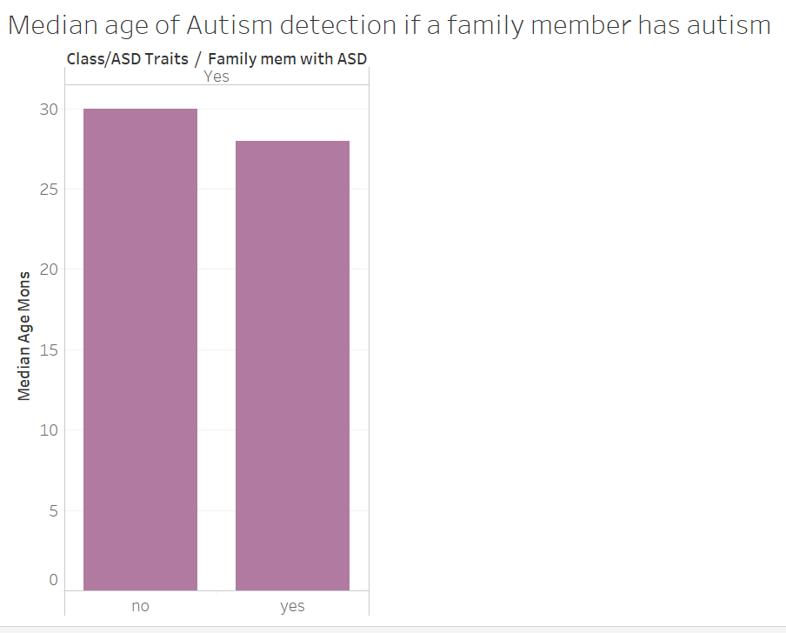
DATA VISUALISATION
If a family member has autism, it doesn’t help in detecting Autism much early

Slide 9
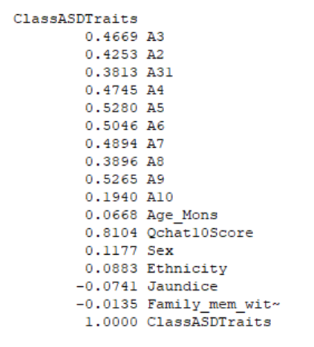
CORRELATION
In order to analyze the data, performed two-class boosted decision tree model
Two-Class Classification algorithm is best suited for this data

Slide 10
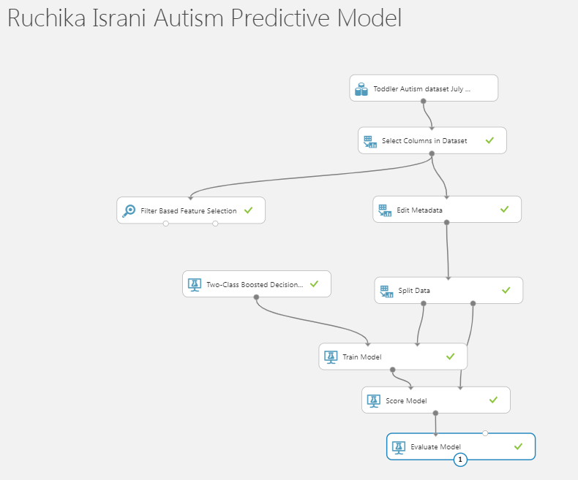
PREDICTIVE MODELING
In order to analyze the data, performed two-class boosted decision tree model
Two-Class Classification algorithm is best suited for this data

Slide 11
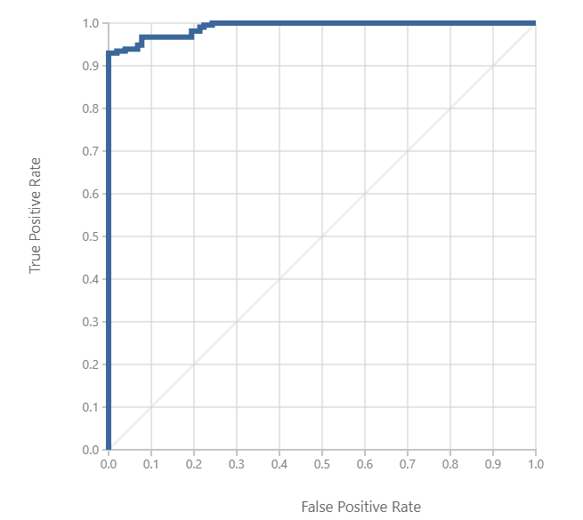
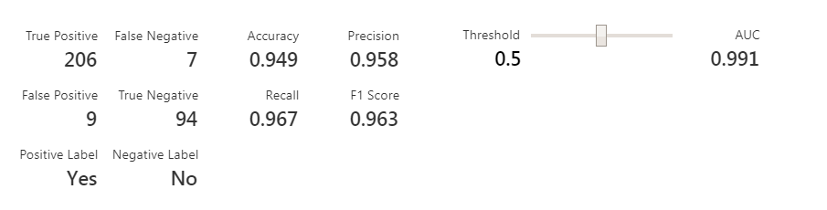
EVALUATION
Two-class boosted decision tree yielded results with 94.9% accuracy

